Slide 1
Guide to Developer / Engineering specs

Slide 2
Agenda
Introduction
What is a dev spec and why do I care?
How do I write effectively write an effective dev spec?
Effectively presenting your spec

Slide 3
What is a dev spec? Why do I care?

Slide 4
What is a developer / engineering spec?
A dev spec is a step along the way of the journey towards building the right feature / product experience
It is a document that represents the engineer’s point of view
But what is the right feature and product experience?
It’s what delights customers
It aligns to Microsoft’s goals
It aligns to our division goals (DevDiv, C+AI)
A dev spec helps us refine these. It does this by helping us:
Refine our goals & customer experiences
Collect feedback from key partners, stakeholders
Communicate our intentions
Notes:
Note: I’m going to use the singular “engineer” throughout this deck to simplify the language, but this applies to specs written by an engineering team.

Slide 5
What is the purpose of a dev spec?
Ultimately – a dev spec communicates what you are building. Through this communication, we can iterate to challenge and verify:
The viability of what we are building
The value of what we are building
The plan for how we are building it
The implications / consequences of how we are building it
By going through this exercise, you hope that you spend the least amount of time building the most value
Notes:
Example – embedded VB compiler in native code as a how implication, which eventually led to Roslyn

Slide 6
Measure of success
The measure of success then is how much time you “save”
Keep in mind though that “time” is not just time to write the initial code; we should also consider support costs, live site issues, and potential re-writes down the line, customer pain points, cost of changes (versioning), and so on
In other words, it can potentially take a long time to evaluate the benefit of a spec, and sometimes, there is higher initial cost that “blinds” us to the real value

Slide 7
Process
Authoring and reviewing dev specs is part of a bigger process
Review process
Code and design update process
Deprecation process

Slide 8
So why should I care?
Product success
Career success
Networking - especially if your spec covers interactions between teams
Mentoring - especially if your spec is a shining example

Slide 9
How do I write one?

Slide 10
What goes into a dev spec?
Ultimately anything and everything you need to achieve your goal
In practice we can use a template to help us and we can add/remove from the template as needed
Since we are in DevDiv, I’m going to focus on spec content and issues that are relevant to “platform” (and maybe less relevant to “applications” and “services”)

Slide 11
Who is the audience?
There is a primary audience – you
Writing specs help you
But there are others to consider:
People who will integrate with your feature
Your immediate team (other engineers, PMs, etc)
Your engineering leadership (managers, architects, etc)
Your partners (engineering partners, PM partners, etc)
Your friends in documentation / writers
Your customers (developers likely will end up using what you are building directly)

Slide 12
How should I proceed with a dev spec?
My preference for ordering:
Table of contents – structure from H1 → H3
Introduction - Background / Context information
Contracts (APIs – bi-directional, file system, etc)
Flows (flows are implementations of scenarios through your contract)
Architecture block diagrams
Revisit the Introduction
Notes:
Table of Contents – helps you organize the structure of the spec before you even begin writing it.
Introduction – ensures that you understand the context – the customers, the scenarios, the requirements, etc
Contracts – anything public facing should come first. This is a good place to iterate and get interim design reviews.
Flows – both data flow and control flow
Block diagrams – how things fit together – both system and local

Slide 13
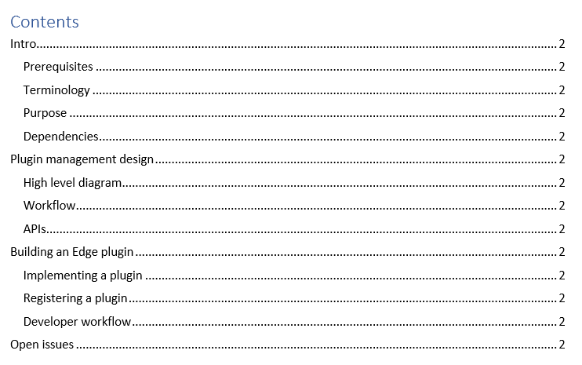
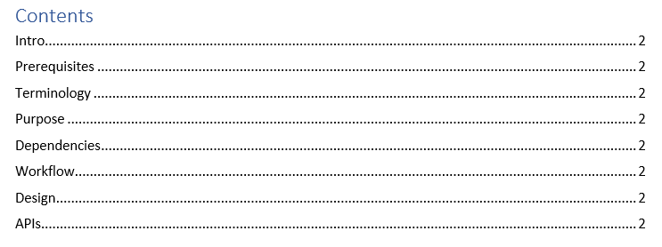
Use the ToC to help structure your document
Think of your document as a communication device. Most authors / song writers have some sort of structure – for example:
Happy state, tension, character building, resolution
Intro, v1, chorus, v2, chorus, bridge, v3, chorus, outro
Build the ToC first:

Slide 14
Start with public contract - APIs
For platforms consider the public contract – things that other developers will be interacting with
Generally the API is the most important public contract
There are two APIs to consider, both important, but in priority order:
The public API contracts
The boundary to your system
The internal API contracts (especially important once your project has multiple people working on it)
The boundary between blocks composing your system

Slide 15
How to start with APIs?
Write a contract in code that you don’t mind (should?) throw away
Interact with the API to test its effectiveness and your design
I will often choose something simple a quick to get started:
For code APIs, I’ll write a simple API contract (in Typescript) and write unit tests
For REST APIs, I’ll use Swagger and test it with Postman / Insomnia
When you have an API, generate docs from it using your favorite doc generator (api-documenter and api-extractor for Typescript)

Slide 16
Discuss other “public contracts”
APIs are not the only public contracts
Consider also:
Developer-facing events (these are really APIs but sometimes we forget that these are)
Logs / events – teams need to build dashboards, monitors, etc on these. These should be documented because changes may break your monitors
Configuration
Database schemas

Slide 17
Once your public contract is done
Review it! (This is the iteration process for design reviews)
Then move on to implementation details:
Data and control flow diagrams
Block diagrams

Slide 18
Flows – data and control flows
Flow diagrams help visualize and document the “workflow“ of operations through your design
Should include global flows and local flows
Control flows
Swim lane / sequence diagrams are a good choice to visualize control flow
Data flows
Shows how data transforms from “input” to “output”
The focus here is to show the transformation of the data and the key processes that affect data
Why work on flows before block diagrams? Flows can help you formulate the right blocks to create. If you create blocks first, you’ll force the flows to fit the blocks
Notes:
For example, if you have a 3 tier architecture – controller, business logic middle tier, and database – you’ll fit all your flows into these boxes. What if one of your flows is event generation? You’ll try to force events into this model – and this is how you get whacky APIs that try to flow event streams through it, instead of leveraging natural event streaming technologies.

Slide 19
Architecture
This section should give a high level view of the architecture – starting from how your feature fits into a larger system, to the way your feature is structured
Building blocks is appropriate here

Slide 20
Service considerations
For services there are additional sections that need to be covered
SLAs
Security
Compliance
Disaster recovery / Continuity
Sharding / Geolocation / Backup

Slide 21
Spec template
I’ve attached a template which might be a good starting point for you
It’s focused on tooling – if there is interest I can extend this to services

Slide 22
Presenting your dev spec

Slide 23
Presenting
Presenting a spec is an important consideration
Presenting can happen via:
A person reading the spec off-line in a doc
A meeting where the author speaks about the doc
The goal of presenting your spec is to:
Communicate the context
Communicate the design
Ask for feedback

Slide 24
Some tips
Practice! Understand the order that you want to present in:
Start with introducing the topic
Describe the interface points next
Finally, go through the design details
Take notes! Actually – have someone take notes for you
Make space for people to give you feedback
If it’s going to take you an hour to go through your spec, you will not have time for feedback, which means you lose a major benefit of this process
Prepare some questions for your audience – engage them

Slide 25
Wrap up

Slide 26
Some myths
Specs are easy to write ➔ they take an incredible amount of time, but they will save you even more time
Specs are too heavy weight ➔ A right-sized spec provides the right balance
Specs slow us down ➔ Specs help us run faster and smoother, especially in the long run
Specs are for “waterfall development methods” ➔ Specs are a tool that can be used in any development method
Specs benefit others ⬄ Specs benefit you
Specs are only useful for “big” things ➔ Specs can be useful even for the smallest feature
Notes:
Spec slow us down - especially as you move into senior bands where you are measured on your work across multiple time horizons

Slide 27

Thank you!
Location of slides and template
Take the survey and give me feedback - https://www.surveymonkey.com/r/JXGGKMF

